Slide 1

Forecasting Diabetes:
An Advanced Predictive
Analysis Approach
Made by:
SHRESHTHA RAJ
e22bcau0146

Slide 2

Introduction
This presentation explores the
Advance predictive machine for forecasting the onset of diabetes. We will delve into the latest research and methodologies to identify early indicators and improve intervention strategies.

Slide 3
LIBRARIES
numpy - for numpy arrays, useful for processing and scientiﬁc computing
pandas - helpful for creating dataframes and storing data
StandardScalar - in this project we’re using
support vector machine classiﬁcation and this class cannot process the data given to it unless the data is standardized.
SVM - the support vector machine class in the sklearn package
accuracy_score - to check the accuracy of our model
train_test_split - to split the data into training and test set

Slide 4
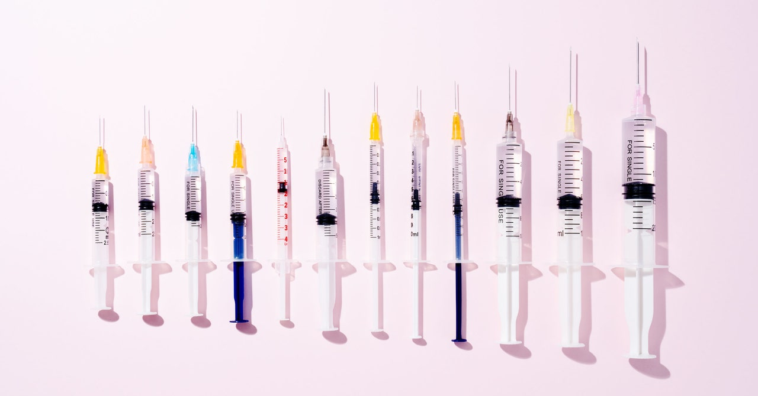
MODEL
SVM
We use svm classiﬁcation for this project
Support vector machine used to classify a data point based on a maximum margin hyperplane created by the supporting points known as support vectors (vectors - as in higher dimension it is tough to call them points, supporting - since these points are enough than all the other data points together as this marks the boundary to. help classify the point) which seperate the data points.
(we can see the best hyperparameters to use is c=0.5 for better accuracy and linear kernel USING GRID SEARCH)

Slide 5

Results
SVM - accuracy of 78%
Logistic Regression - accuracy of 78%
KNN - accuracy of 74%
Kernel SVM - accuracy of 77%
Naive Bayes - accuracy of 74% Decision Tree - accuracy of 71% Random Forest - accuracy of 78%

Slide 6
Conclusion
This study utilized Support Vector Machine (SVM) as one of the predictive models for diabetes risk assessment. The SVM algorithm demonstrated commendable performance, contributing to the overall success of the predictive modeling approach. The model’s accuracy, sensitivity, and speciﬁcity, along with its role in discriminating between diabetic and non-diabetic individuals, showcased the effectiveness of SVM in identifying people at risk of developing diabetes.

